Slide 1
Hospitality Project

Slide 2
Team:
1. Vyankatesh Magnur
2. Akhilesh Parate
3. Baseera Mohammadi sk

Slide 3
Summary :
The project focuses on analyzing key performance indicators (KPIs) such as Total Revenue, Occupancy, Cancellation Rate, and Booking trends to optimize hotel operations. The data will be collected, cleaned, and analyzed to identify trends, forecast demand, and improve revenue management strategies. The analysis includes exploring revenue and booking patterns by day of the week, state, and hotel, as well as understanding capacity utilization and guest behavior. The final deliverables include interactive dashboards and reports to provide actionable insights for improving overall hotel performance.

Slide 4
KPIs :
Total Revenue
Occupancy
Cancellation Rate
Total Booking
Utilize Capacity
Trend Analysis
Weekday & Weekend Revenue and Booking
Revenue by State & Hotel
Class wise Revenue
Checked out cancelled No show
Weekly trend Key Trend (Revenue, Total Booking, Occupancy)

Slide 5
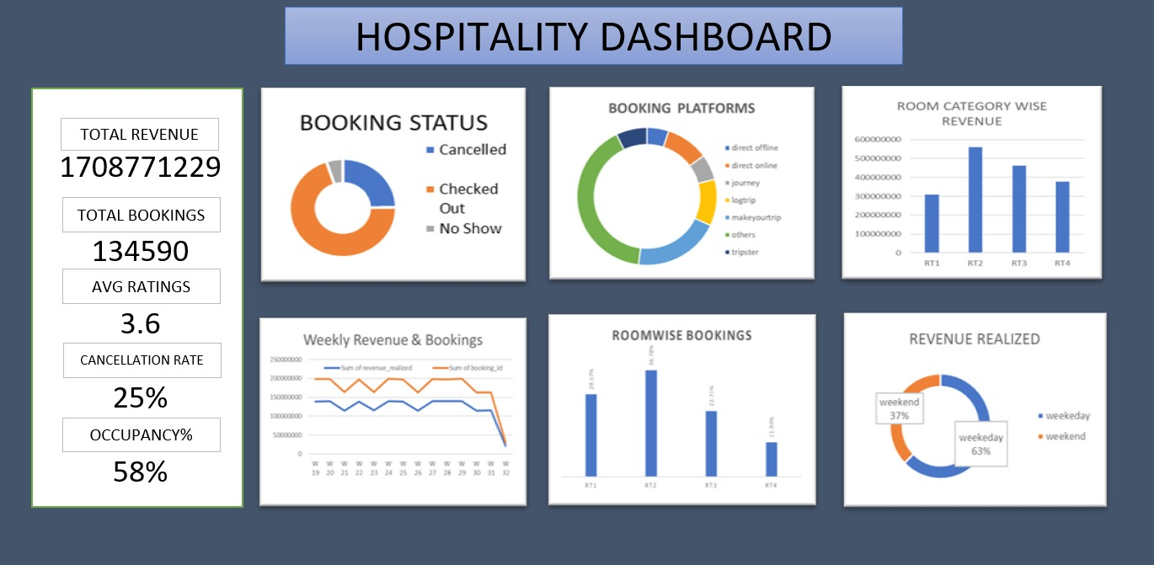
Excel Dashboard :

Slide 6
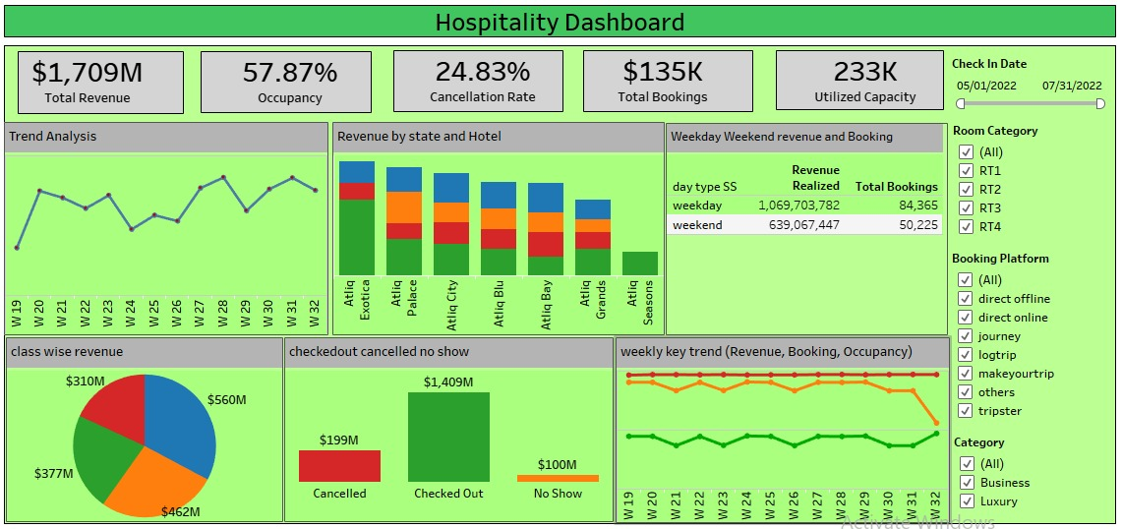
Tableau Dashboard

Slide 7
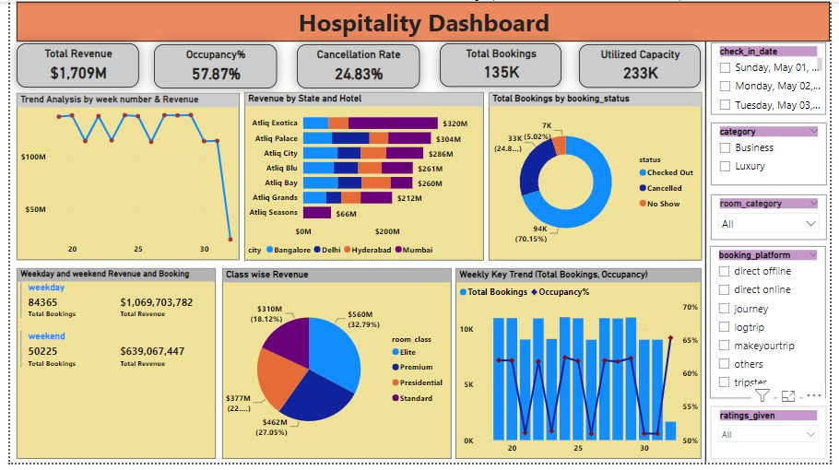
Power BI Dashboard :

Slide 8
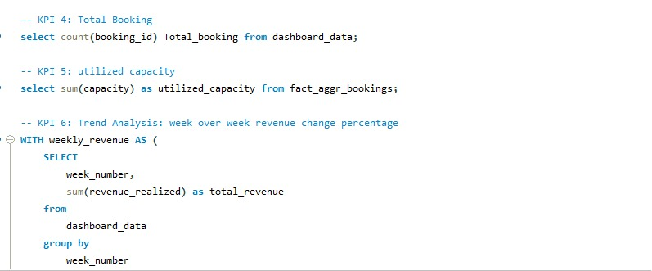
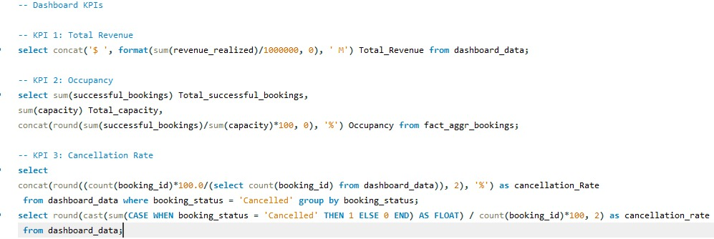
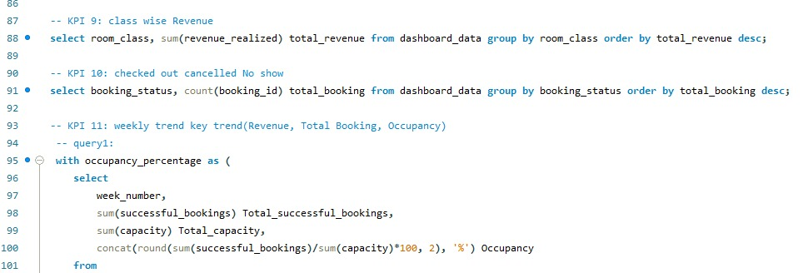
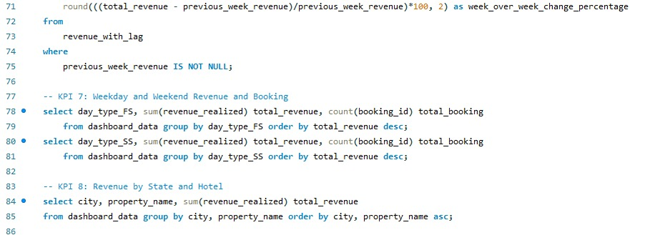
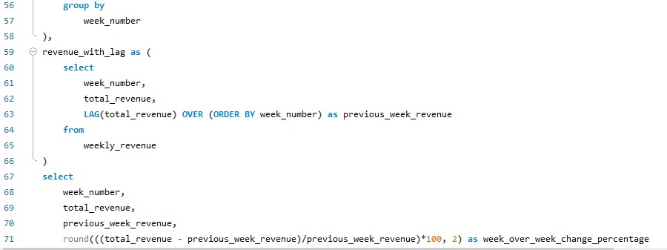
SQL Queries :

Slide 9
Conclusion :
In conclusion, the project will deliver actionable insights to optimize hotel operations, boost revenue, and enhance guest satisfaction, driving better decision-making and competitive advantage.

Slide 10
Thank You

